Slide 1
Ride Sharing Service
-Abhiram

Slide 2
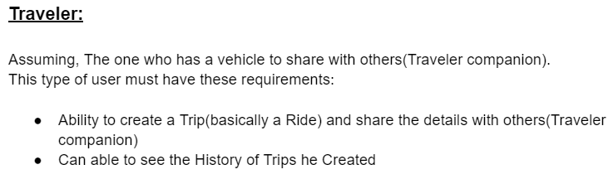
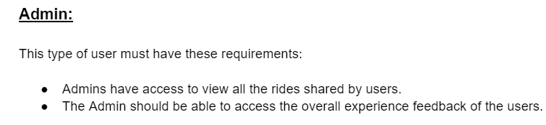
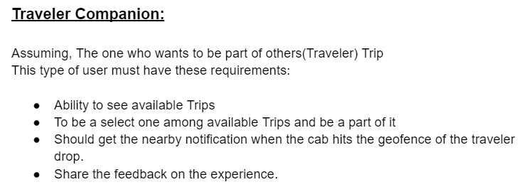
Requirements

Slide 3
Design-Class
User
Traveler
TravelerCompanion
Admin
Trip
TripEvent
FeedBack
TripStatus
TripManager(Singleton)(system)
NotificationMgr(Singleton)
iNotificationSender
SMSNotification Sender
WhatsAppNotificationSender

Slide 4
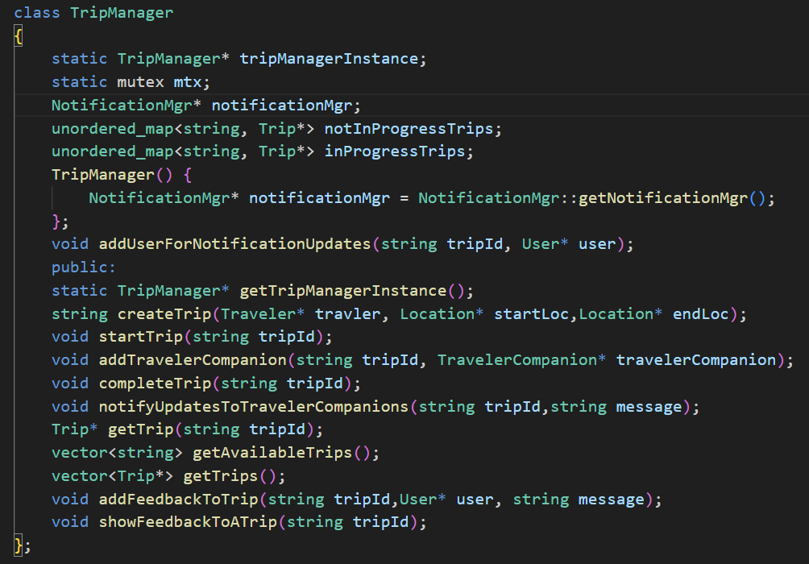
TripManager-System

